Slide 1
Apache SPARK

Slide 2
HADOOP APPLICATIONS
Industries are using Hadoop extensively to analyze their data sets.
The reason is that Hadoop framework is based on a simple programming model (MapReduce) and it enables a computing solution that is scalable, flexible, fault-tolerant and cost effective.
Here, the main concern is to maintain speed in processing large datasets in terms of waiting time between queries and waiting time to run the program.

Slide 3
SPARK
Spark was introduced by Apache Software Foundation for speeding up the Hadoop computational computing software process.
Spark is not a modified version of Hadoop and is not, really, dependent on Hadoop because it has its own cluster management.
Hadoop is just one of the ways to implement Spark.
Spark uses Hadoop in two ways – one is storage and second is processing.

Slide 4
Apache Spark
Apache Spark is a lightning-fast cluster computing technology, designed for fast computation.
It is based on Hadoop MapReduce
It extends the MapReduce model to efficiently use it for interactive queries and stream processing.
The main feature of Spark is its in-memory cluster computing that increases the processing speed of an application.
Spark is designed to cover a wide range of workloads such as batch applications, iterative algorithms, interactive queries and streaming.
It reduces the management burden of maintaining separate tools.

Slide 5
Evolution of Apache Spark
Spark is one of Hadoop’s sub project developed in 2009 in UC Berkeley’s AMPLab by Matei Zaharia.
It was Open Sourced in 2010 under a BSD license.
It was donated to Apache software foundation in 2013, and now Apache Spark has become a top level Apache project from Feb-2014.
Latest version of Apache Spark is 3.5.0, released on September 13, 2023.

Slide 6
Features of Apache Spark
Speed − Spark helps to run an application in Hadoop cluster, up to 100 times faster in memory, and 10 times faster when running on disk. This is possible by reducing number of read/write operations to disk. It stores the intermediate processing data in memory.
Supports multiple languages − Spark provides built-in APIs in Java, Scala, or Python. 80 high-level operators for interactive querying is supported.
Advanced Analytics − Spark not only supports ‘Map’ and ‘reduce’. It also supports SQL queries, Streaming data, Machine learning (ML), and Graph algorithms.

Slide 7
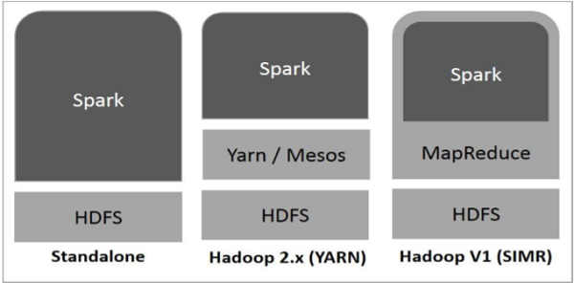
Spark Built on Hadoop
Apache Mesos is an open-source project to manage computer clusters

Slide 8
Three ways of Spark deployment
Standalone − It means Spark occupies the place on top of HDFS and space is allocated for HDFS, explicitly. Here, Spark and MapReduce will run side by side to cover all spark jobs on cluster.
Hadoop Yarn − Hadoop Yarn deployment means, simply, spark runs on Yarn without any pre-installation or root access required. It helps to integrate Spark into Hadoop ecosystem or Hadoop stack. It allows other components to run on top of stack.
Spark in MapReduce (SIMR) − Spark in MapReduce is used to launch spark job in addition to standalone deployment. With SIMR, user can start Spark and uses its shell without any administrative access.

Slide 9
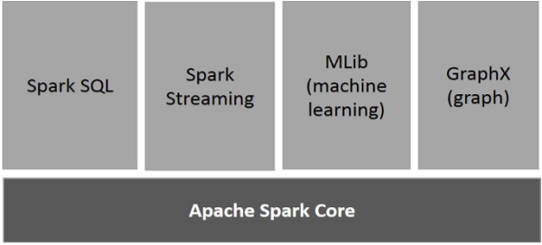
Components of Spark

Slide 10
Components of Spark cont..
Apache Spark Core
General execution engine for spark platform that all other functionality is built upon. It provides In-Memory computing and referencing datasets in external storage systems.
Spark SQL
Spark SQL is a component on top of Spark Core that introduces a new data abstraction called SchemaRDD, which provides support for structured and semi-structured data.

Slide 11
Components of Spark
Spark Streaming
Spark Streaming leverages Spark Core's fast scheduling capability to perform streaming analytics.
It ingests data in mini-batches and performs RDD (Resilient Distributed Datasets) transformations on those mini-batches of data.
MLlib (Machine Learning Library)
MLlib is a distributed machine learning framework above Spark because of the distributed memory-based Spark architecture.
It is, according to benchmarks, done by the MLlib developers against the Alternating Least Squares (ALS) implementations.
Spark MLlib is nine times as fast as the Hadoop disk-based version of Apache Mahout (before Mahout gained a Spark interface).

Slide 12
GraphX
GraphX is a distributed graph-processing framework on top of Spark.
It provides an API for expressing graph computation that can model the user-defined graphs by using Pregel abstraction API.
It also provides an optimized runtime for this abstraction.

Slide 13
Resilient Distributed Datasets (RDDs)
RDDs are the main logical data units in Spark.
A distributed collection of objects, which are stored in memory or on disks of different machines of a cluster.
A single RDD can be divided into multiple logical partitions so that these partitions can be stored and processed on different machines of a cluster.
RDDs are immutable (read-only) in nature. cannot change an original RDD, can create new RDDs by performing coarse-grain operations, like transformations, on an existing RDD.

Slide 14
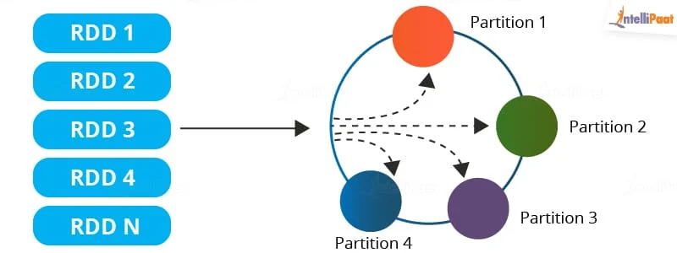
An RDD in Spark can be cached and used again for future transformations, which is a huge benefit for users. RDDs are said to be lazily evaluated, i.e., they delay the evaluation until it is really needed. This saves a lot of time and improves efficiency.

Slide 15
Features of an RDD in Spark
Resilience: RDDs track data lineage information to recover lost data, automatically on failure. It is also called fault tolerance.
Distributed: Data present in an RDD resides on multiple nodes. It is distributed across different nodes of a cluster.
Lazy evaluation: Data does not get loaded in an RDD even if you define it. Transformations are actually computed when you call action, such as count or collect, or save the output to a file system.

Slide 16
Immutability: Data stored in an RDD is in the read-only mode. But, you can create new RDDs by performing transformations on the existing RDDs.
In-memory computation: An RDD stores any immediate data that is generated in the memory (RAM) than on the disk so that it provides faster access.
Partitioning: Partitions can be done on any existing RDD to create logical parts that are mutable. Applying transformations to the existing partitions.

Slide 17
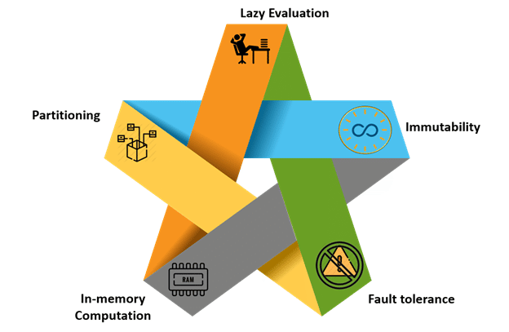

Slide 18
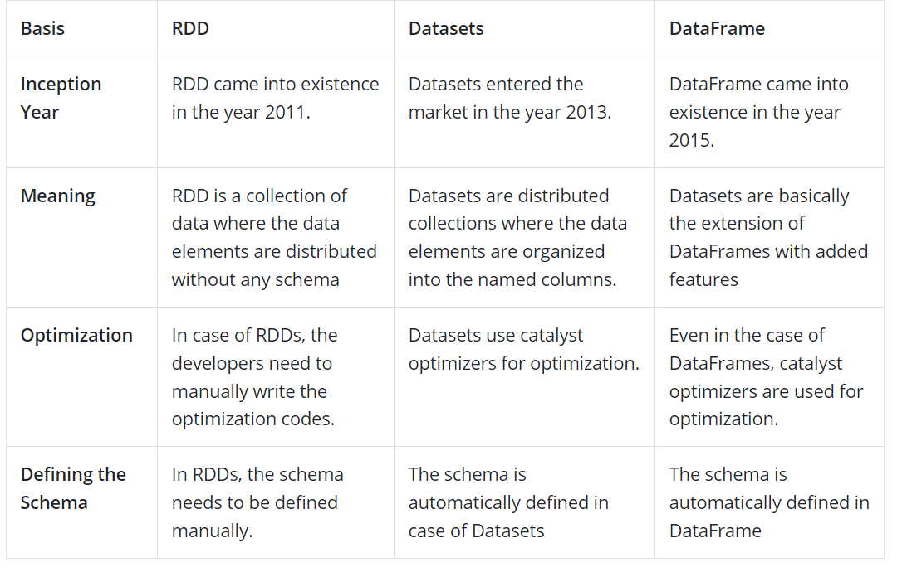
Differentiation: RDD vs Datasets vs DataFrame

Slide 19
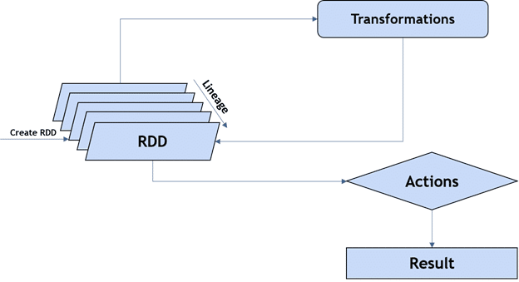
Operations on RDDs

Slide 20
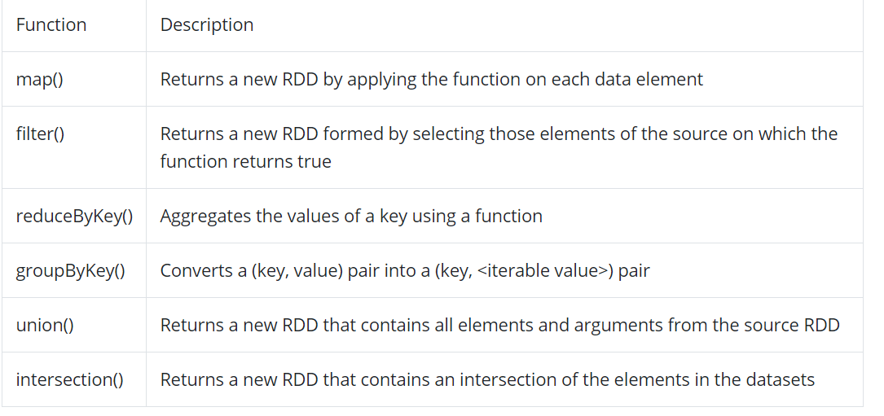
Transformations
Functions accept the existing RDDs as input and output one or more RDDs. However, the data in the existing RDD in Spark does not change as it is immutable.

Slide 21
Actions
Actions in Spark are functions that return the end result of RDD computations.
It uses a lineage graph to load data onto the RDD in a particular order.
After all of the transformations are done, actions return the final result to the Spark Driver.
Actions are operations that provide non-RDD values.

Slide 22
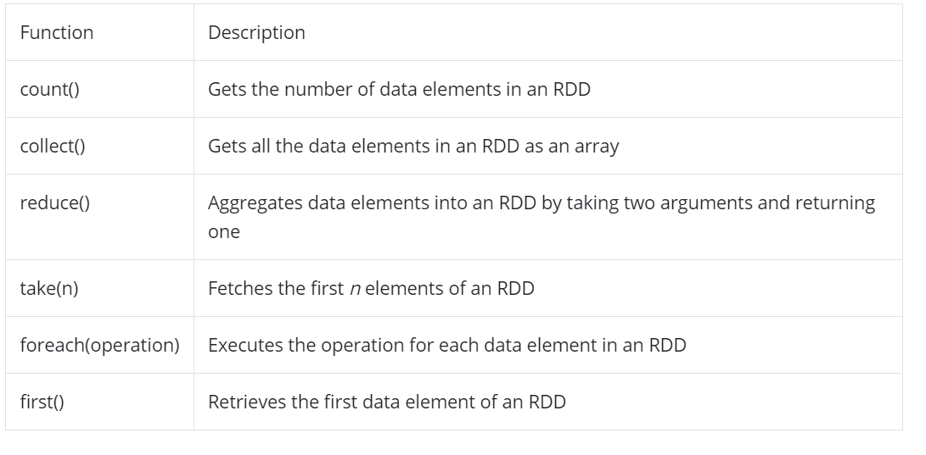

Slide 23
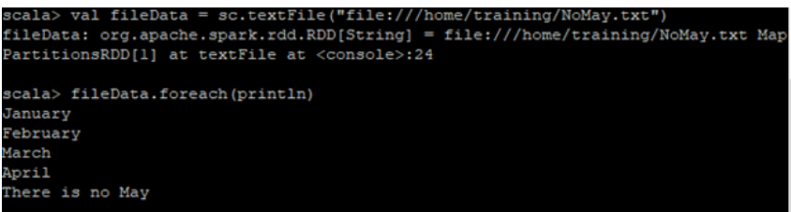
Creating an RDD
An RDD can be created in three ways. Let’s discuss them one by one.
By Loading an External Dataset
An external file can be loaded onto an RDD.
Supported file types are csv, txt, JSON, etc. Example of loading a text file onto an RDD:

Slide 24
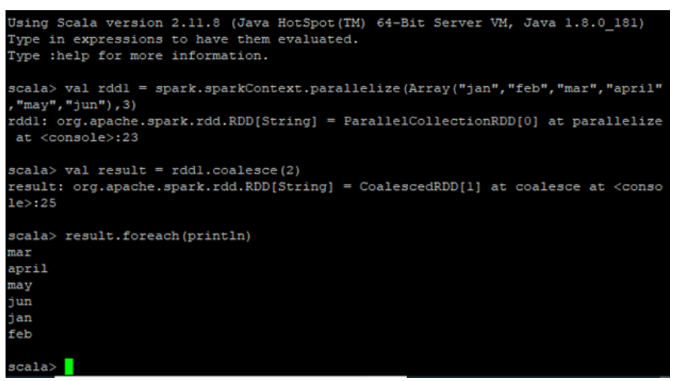
By Parallelizing the Collection of Objects
When Spark’s parallelize method is applied to a group of elements, a new distributed dataset is created. This dataset is an RDD.

Slide 25
By Performing Transformations on the Existing RDDs
One or more RDDs can be created by performing transformations on the existing RDDs as mentioned earlier in this tutorial page.

Slide 26
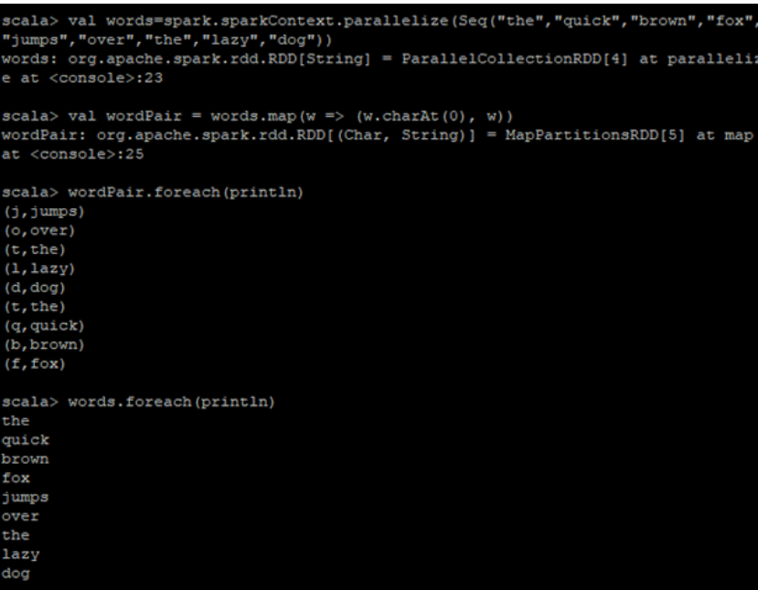

Slide 27
Advantages of RDD
RDD aids in increasing the execution speed of Spark.
RDDs are the basic unit of parallelism and hence help in achieving the consistency of data.
RDDs help in performing and saving the actions separately
They are persistent as they can be used repeatedly.

Slide 28
RDD Persistence
persisting (or caching) a dataset in memory across operations.
Each node stores any partitions of it that it computes in memory and reuses them in other actions on that dataset
This allows future actions to be much faster (often by more than 10x).
Using the persist() or cache() methods on it.
The first time it is computed in an action, it will be kept in memory on the nodes.
Spark’s cache is fault-tolerant – if any partition of an RDD is lost, it will automatically be recomputed using the transformations that originally created it.

Slide 29
Storage Level | Meaning
MEMORY_ONLY | Store RDD as deserialized Java objects in the JVM. If the RDD does not fit in memory, some partitions will not be cached and will be recomputed on the fly each time they're needed. This is the default level.
MEMORY_AND_DISK | Store RDD as deserialized Java objects in the JVM. If the RDD does not fit in memory, store the partitions that don't fit on disk, and read them from there when they're needed.
MEMORY_ONLY_SER (Java and Scala) | Store RDD as serialized Java objects (one byte array per partition). This is generally more space-efficient than deserialized objects, especially when using a fast serializer, but more CPU-intensive to read.

Slide 30
Storage Level | Meaning
MEMORY_AND_DISK_SER (Java and Scala) | Similar to MEMORY_ONLY_SER, but spill partitions that don't fit in memory to disk instead of recomputing them on the fly each time they're needed.
DISK_ONLY | Store the RDD partitions only on disk.
MEMORY_ONLY_2, MEMORY_AND_DISK_2, etc. | Same as the levels above, but replicate each partition on two cluster nodes.
OFF_HEAP (experimental) | Similar to MEMORY_ONLY_SER, but store the data in off-heap memory. Th Off-Heap Memory — This segment of memory lies outside the JVM, but is used by JVM for certain use-cases (e.g. interning of Strings)is requires off-heap memory to be enabled.

Slide 31
Passing functions to SPARK
Spark’s API relies heavily on passing functions in the driver program to run on the cluster. There are two recommended ways to do this:
Anonymous function syntax, which can be used for short pieces of code.
Static methods in a global singleton object.
For example, you can define object MyFunctions and then pass MyFunctions.func1, as follows:
object MyFunctions { def func1(s: String): String = { ... } } myRdd.map(MyFunctions.func1)

Slide 32
Sending the object that contains that class along with the method
object MyFunctions{
def func1(s: String): String = { ... }
}
myRdd.map(MyFunctions.func1)

Slide 33
Create a new MyClass instance and call doStuff on it, the map inside references the func1 method of that MyClass instance, so the whole object needs to be sent to the cluster. It is similar to writing rdd.map(x => this.func1(x)).
class MyClass {
def func1(s: String): String = { ... }
def doStuff(rdd: RDD[String]): RDD[String] = { rdd.map(func1) }
}

Slide 34
Scala Basics
Scala program, it can be defined as a collection of objects that communicate via invoking each other’s methods

Slide 35
Components of a Scala Program
Object − Objects have states and behaviors. An object is an instance of a class. Example − A dog has states - color, name, breed as well as behaviors - wagging, barking, and eating.
Class − A class can be defined as a template/blueprint that describes the behaviors/states that are related to the class.
Methods − A method is basically a behavior. A class can contain many methods. It is in methods where the logics are written, data is manipulated and all the actions are executed.

Slide 36
Components of a Scala Program Cont..
Fields − Each object has its unique set of instance variables, which are called fields. An object's state is created by the values assigned to these fields.
Closure − A closure is a function, whose return value depends on the value of one or more variables declared outside this function.
Traits − A trait encapsulates method and field definitions, which can then be reused by mixing them into classes. Traits are used to define object types by specifying the signature of the supported methods.

Slide 37
Scala Program
scala> println("Hello, Scala!");
It will produce the following result −
Hello, Scala!

Slide 38
Scala Variables and Data Types
Example of variable 1
var data = 100
>data = 101
var →keyword
data →variable name.
It contains an integer value 100.
Example of variable 2
var data:Int = 100
// Here,
Int followed by : (colon)
Variable is a name which is used to refer memory location.
Two types of varibale in Scala:
Mutable
Immutable variable
Mutable Variable (var)
create mutable variable using var keyword.
It changes value after declaration of variable.

Slide 39
Scala Variables and Data Types
Immutable Variable (val)
Code throws an error
Because content of immutable variable (data), has been changed
So to change value use var instead of val.
.
Example Immutable variable
val data = 100
data = 101
// Error: reassignment to val

Slide 40
Data Types in Scala
Boolean
Byte
Short
Char
Int
Long
Float
Double
String
Similar to java in terms of their storage, length
In scala there is no concept of primitive data types
Every type is an object and starts with capital letter.

Slide 41
Script Mode
Open notepad and add the following code into it.
Example
object HelloWorld {
def main(args: Array[String]) {
println("Hello, world!") // prints Hello World
}
}
Save the file as − HelloWorld.scala
Use the following command to compile and execute your Scala program.
\> scalac HelloWorld.scala
\> scala HelloWorld
Output
Hello, World!

Slide 42
Scala Keywords
abstract case catch class
def do else extends
false final finally for
forSome if implicit import
lazy match new Null
object override package private
protected return sealed super
this throw trait Try
true type val Var
while with yield
- : = =>
<- <: <% >:
# @

Slide 43
Basic syntaxes and coding conventions in Scala programming
Case Sensitivity − Scala is case-sensitive, for example identifier Hello and hello would have different meaning in Scala.
Class Names − For all class names, the first letter should be in Upper Case.
Example − class MyFirstScalaClass.
Method Names − All method names should start with a Lower Case letter.
Example − def myMethodName()

Slide 44
Program File Name − Name of the program file should exactly match the object name.
Saving the file using the object name and append ‘.scala’ to the end of the name.
Example − 'HelloWorld' object is saved as 'HelloWorld.scala'.
def main(args: Array[String]) − Scala program processing starts from the main() method which is a mandatory part of every Scala Program.

Slide 45
Conditional Statement
If statement
If-else statement
Nested if-else statement
If-else-if ladder statement

Slide 46
Scala if statement
Syntax
if(condition){
// Statements to be executed
}
Example
var age:Int = 20;
if(age > 18){
println ("Age is greate than 18")
}
Statement is used to test condition in scala.
“If” block executes only when condition is true otherwise execution of “if” block is skipped.

Slide 47
If-else Statement
Syntax
if(Boolean_expression)
{ //Executes when the Boolean expression is true
}
else
{ //Executes when the Boolean expression is false
}
An ‘if’ statement can be followed by an optional else
statement, which executes when the Boolean expression is false.

Slide 48
Example
object TestIf
{
def main(args: Array[String])
{ var x = 30;
if( x < 20 )
{
println("This is if statement");
}
else
{
println("This is else statement");
}
}
}
Save the above program in TestIf.scala.
Command
\>scalac TestIf.scala
\>scala TestIf
Output
This is else statement

Slide 49
Scala Pattern Matching
Example 1 code snippet
object MainObject {
def main(args: Array[String]) {
var x = 1
x match{
case 1 => println(“Good")
case 2 => println(“Excellent”)
case _ => println(“Average")
}
}
Output:
Good
match using a variable x.
variable x matches with best available case and prints output.
Underscore (_) is used in the last case for making it default case.

Slide 50
Scala Pattern Matching
Example 1 code snippet
object MainObject {
def main(args: Array[String]) {
var x = search (“Excellent")
print(x)
}
def search (y:Any):Any = y match{
case 1 => println(“Good")
case "Two" => println(“Excellent")
case "Hello" => println(“Average")
case _ => println(“Redo")
}
}
Output:
Excellent
Defining method having a match with cases for any type of data.
Any is a class in scala
It is a super class of all data types
It deals with all type of data.

Slide 51
Loop Type & Description
1 while loop
Repeats a statement or group of statements while a given condition is true. It tests the condition before executing the loop body.
2 do-while loop
Like a while statement, except that it tests the condition at the end of the loop body.
3 for loop
Executes a sequence of statements multiple times and abbreviates the code that manages the loop variable.

Slide 52
Scala while loop
Example code snippet
object MainObject {
def main(args: Array[String]) { var x = 10;
while( x<=20 ){
println(x);
x = x+2
}
}
}
Output:
10
12
14
16
18
20
Used to iterate code till the specified condition.
It tests boolean expression and iterates again and again.
It is used when the number of iterations are not known prior.
Syntax
while(boolean expression){
// Statements to be executed
}

Slide 53
Scala do-while loop example
object MainObject {
def main(args: Array[String]) {
var a = 10;
do {
println( a );
a = a + 2;
}
while( a <= 20 )
}
}
Output:
10 12 14 16 18 20

Slide 54
Scala for loop (for-comprehensions)
In scala, for loop is known as for-comprehensions.
It can be used to iterate, filter and return an iterated collection.
The for-comprehension looks a bit like a for-loop in imperative languages, except that it constructs a list of the results of all iterations.
Types of for loop (loops using)
To
Until
By
Filter
Yield
Collection
Syntax
for( i <- range){
// statements to be executed
}
range is a value which has start and end point.
pass range by using to or until keyword.
Example
object MainObject {
def main(args: Array[String]) {
for( a <- 1 to 10 ){
println(a);
}
}
}

Slide 55
Scala for-loop Example by using until keyword
object MainObject {
def main(args: Array[String]) {
for( a <- 1 until 10 ){
println(a);
}
}
}

Slide 56
Scala for-loop filtering Example
Example
object MainObject {
def main(args: Array[String]) {
for( a <-1 to 10 if a%2==0 ){
println(a);
}
}
}
Use for to filter the data.
Filter the data by passing a conditional expression.
This program prints only even values in the given range.

Slide 57
Scala for-loop Example by using yield keyword
Example
object MainObject {
def main(args: Array[String]) {
var result = for( a <-1 to 10) yield a
for(i<-result){
println(i)
}
}
}
Use yield keyword to return a result after completing of loop iterations.
The for use buffer internally to store iterated result and after finishing all iterations it yields the final result from that buffer.
It does not work like imperative loop

Slide 58
Scala for-loop in Collection
Example Code Snippet
object MainObject {
def main(args: Array[String]) {
var list = List(1,2,3,4,5)
for( i <- list){
println(i)
}
}
}
Output:
1
2
3
4
5
Iterates collections like list, sequence etc, either by using for each loop or for-comprehensions

Slide 59
Scala for-each loop Example for Iterating Collection
object MainObject { def main(args: Array[String]) { var list = List(1,2,3,4,5,6,7,8,9) // Creating a list list.foreach{ println // Print each element } list.foreach(print) println list.foreach((element:Int)=>print(element+" "))
// Explicitly mentioning type of elements } }

Slide 60
Scala for-loop using by keyword
Example
object MainObject {
def main(args: Array[String]) {
for(i<-1 to 10 by 2){
println(i)
}
}
}
In the above example, we have used by keyword.
The by keyword is used to skip the iteration.
When you code like: by 2 it means, this loop will skip all even iterations of loop.
Output:
1
3
5
7
9

Slide 61
Loop Control Statements
Example
object Demo {
def main(args: Array[String]) {
var a = 10; // An infinite loop.
while( true ){
println( "Value of a: " + a );
}
}
}
Break statement
Terminates the loop statement and transfers execution to the statement immediately following the loop

Slide 62
FUNCTIONS
A function is a group of statements that perform a task. You can divide up your code into separate functions. How you divide up your code among different functions is up to you, but logically, the division usually is so that each function performs a specific task.
Scala has both functions and methods and we use the terms method and function interchangeably with a minor difference. A Scala method is a part of a class which has a name, a signature, optionally some annotations, and some bytecode where as a function in Scala is a complete object which can be assigned to a variable. In other words, a function, which is defined as a member of some object, is called a method.
A function definition can appear anywhere in a source file and Scala permits nested function definitions, that is, function definitions inside other function definitions. Most important point to note is that Scala function's name can have characters like +, ++, ~, &,-, --, \, /, :, etc.

Slide 63
Scala Functions
Scala supports functional programming approach.
It provides rich set of built-in functions and allows you to create user defined functions also.
In scala, functions are first class values.
Function value can be stored, pass function as an argument and return function as a value from other function.
Create function by using def keyword.
Mention return type of parameters while defining function and return type of a function is optional.
If don't specify return type of a function, default return type is Unit. ( It can be stated as null, no value, or nothing in return)

Slide 64
Scala Function Declaration Syntax
In the given syntax, = (equal) operator is used
Create function with or without = (equal) operator.
If = symbol is used, function will return value.
Otherwise, it will not return anything and will work like subroutine.
Syntax
def functionName(parameters : typeofparameters) : returntypeoffunction = {
// statements to be executed
}

Slide 65
Scala Function Example without using = Operator
Example
object MainObject {
def main(args: Array[String]) {
functionExample() // Calling function
}
def functionExample() { // Defining a function
println("This is a simple function")
}
}
Output:
This is a simple function
The function defined is also known as
“non parameterized function”

Slide 66
Scala Function Example with = Operator
Example
object MainObject {
def main(args: Array[String]) {
var result = functionExample() // Calling function
println(result)
}
def functionExample() = { // Defining a function
var a = 10
a
}
}

Slide 67
Scala Parameterized Function
Example
object MainObject {
def main(args: Array[String]) = {
functionExample(10,20)
}
def functionExample(a:Int, b:Int) = {
var c = a+b
println(c)
}
}
When using parameterized function mention the type of parameters explicitly.
Otherwise compiler throws an error and the code fails to compile.

Slide 68
Scala Recursion Function
Example
object MainObject {
def main(args: Array[String]) = {
var result = functionExample(15,2)
println(result)
}
def functionExample(a:Int, b:Int):Int = {
if(b == 0) // Base condition
0
else
a+functionExample(a,b-1)
}
}
Multiplying two numbers by using recursive function.
Create recursive functions
There must be a base condition to terminate program safely.

Slide 69
Function Parameter with Default Value
Example
object MainObject {
def main(args: Array[String]) = {
var result1 = functionExample(15,2) // Calling with two values
var result2 = functionExample(15) // Calling with one value
var result3 = functionExample()
// Calling without any value
println(result1+"\n"+result2+"\n"+result3)
}
def functionExample(a:Int = 0, b:Int = 0):Int = { // Parameters with default values as 0
a+b
}
}
Scala provides a feature to assign default values to function parameters.
It helps in the scenario when you don't pass value during function calling.
It uses default values of parameters
Output:
17
15
0

Slide 70
Scala Function Named Parameter
Example
object MainObject {
def main(args: Array[String]) = {
var result1 = functionExample(a = 15, b = 2);
var result2 = functionExample(b = 15, a = 2) ;
var result3 = functionExample(15,2) ;
println(result1+"\n"+result2+"\n"+result3)
}
def functionExample(a:Int, b:Int):Int = {
a+b
}
}
In scala function, the names of parameters can be specified during calling the function.
In the given example, parameter names are passing during calling.
Named parameters can be passed in any order and can also pass values only.
Output:
17
17
17

Slide 71
Scala Array
Array is a collection of mutable values.
It is an index based data structure which starts from 0 index to n-1 where n is length of array.
Scala arrays can be generic.
It means, an Array[T], where T is a type parameter or abstract type.
Scala arrays are compatible with Scala sequences - ie can pass an Array[T] where a Seq[T] is required.
It also supports all the sequence operations.

Slide 72
Scala Types of array
Single dimensional array
Multidimensional array

Slide 73
Scala Single Dimensional Array
Array Declaration
var arrayName : Array[arrayType] = new Array[arrayType](arraySize);
or
var arrayName = new Array[arrayType](arraySize)
or
var arrayName : Array[arrayType] = new Array(arraySize);
or
var arrayName = Array(element1, element2 ... elementN)
Single dimensional array is used to store elements in linear order.
Array elements are stored in contiguous memory space.
So, if any index of an array is available then, all the elements of the array can be traversed easily.

Slide 74
Scala Array Example: Single Dimensional
class ArrayExample{
var arr = Array(1,2,3,4,5) // Creating single dimensional array
def show(){
for(a<-arr) // Traversing array elements
println(a)
println("Third Element = "+ arr(2)) // Accessing elements by using index
} }
object MainObject{
def main(args:Array[String]){
var a = new ArrayExample()
a.show()
} }
Output:
1
2
3
4
5
Third Element = 3

Slide 75
Scala Passing Array into Function
Example
class ArrayExample{
def show(arr:Array[Int]){
for(a<-arr)
println(a)
println("Third Element = "+ arr(2)) }
}
object MainObject{
def main(args:Array[String]){
var arr = Array(1,2,3,4,5,6)
var a = new ArrayExample()
a.show(arr)
}
}
Pass array as an argument to function during function call.
Output:
1
2
3
4
5
6
Third Element = 3

Slide 76
Scala Array Example: Iterating By using Foreach Loop
Iterate array elements by using foreach loop.
class ArrayExample{
var arr = Array(1,2,3,4,5)
arr.foreach((element:Int)=>println(element))
}
object MainObject{
def main(args:Array[String]){
new ArrayExample()
}
}
Output:
1
2
3
4
5

Slide 77
Scala Multidimensional Array
Multidimensional Array Syntax
var arrayName = Array.ofDim[ArrayType](NoOfRows,NoOfColumns)
or
var arrayName = Array(Array(element...), Array(element...), ...)
Multidimensional array is an array which store data in matrix form
Two dimensional to three, four and many more dimensional array can be created
Scala provides an ofDim method to create multidimensional array

Slide 78
Scala Multidimensional Array by using ofDim
class ArrayExample{
var arr = Array.ofDim[Int](2,2)
// Creating multidimensional array
arr(1)(0) = 15 // Assigning value
def show(){
for(i<- 0 to 1) { // Traversing elements by using loop
for(j<- 0 to 1){
print(" "+arr(i)(j))
}
println()
}
println("Third Element = "+ arr(1)(1)) // Accessing elements by using index
}
}
In this example, created an array by using ofDim method.
Output:
0 0
15 0
Third Element = 0
object MainObject{
def main(args:Array[String]){
var a = new ArrayExample()
a.show()
}
}

Slide 79
Scala Addition of Two Matrix
class ArrayMatAdd{
var arr1 = Array(Array(1,2,3,4,5), Array(6,7,8,9, 10))
var arr2 = Array(Array(1,2,3,4,5), Array(6,7,8,9,10))
var arr3 = Array.ofDim[Int](2,5)
def show(){
for(i<- 0 to 1){ // Traversing elements using loop
for(j<- 0 to 4){
arr3(i)(j) = arr1(i)(j)+arr2(i)(j)
print(" "+arr3(i)(j))
}
println()
}
}
}
object MainObject{
def main(args:Array[String]){
var a = new ArrayMatAdd()
a.show()
}
}
Output:
2 4 6 8 10
12 14 16 18 20

Slide 80
Scala Maps
Map is used to store elements.
It stores elements in pairs of key and values.
In scala, map is created by using
Comma separated pairs
Rocket operator. (Rocket (=>)It is used to create function literals.
For example
scala> (x:Int, y:Int)=>{x+y} res12: (Int, Int) => Int = <function2>)

Slide 81
Scala maps Example
//both approaches to create map.
object MainObject{
def main(args:Array[String]){
var map = Map(("A","Apple"),("B","Ball"))
var map2 = Map("A"->"Aple","B"->"Ball")
var emptyMap:Map[String,String] = Map.empty[String,String]
println(map)
println(map2)
println("Empty Map: "+emptyMap)
}
}
Output:
Map(A -> Apple, B -> Ball)
Map(A -> Aple, B -> Ball)
Empty Map: Map()

Slide 82
Scala Map : Adding and Removing Elements
object MainObject{
def main(args:Array[String]){
var map = Map("A"->"Apple","B"-> “Ball” )
// Creating map
println(map("A")) // Accessing value by using key
var newMap = map+("C"->”Cat” )
// Adding a new element to map
println(newMap)
var removeElement = newMap - (“B”)
// Removing an element from map
println(removeElement)
}
}
To add and remove new elements in maps Scala provides lots of predefined method.
Example
Map+
newMap-
Output:
Apple
Map(A -> Apple, B -> Ball, C -> Cat)
Map(A -> Apple, C -> Cat)

Slide 83
Scala Tuples
//Tuple of different types of elements.
object MainObject{
def main(args:Array[String]){
var tuple = (1,5,8,6,4) // Tuple of integer values
var tuple2 = ("Apple","Banana","Gavava") // Tuple of string values
var tuple3 = (2.5,8.4,10.50) // Tuple of float values
var tuple4 = (1,2.5,"India") // Tuple of mix type values
println(tuple)
println(tuple2)
println(tuple3)
println(tuple4)
}
}
A tuple is a collection of elements in ordered form.
If there is no element present, it is called empty tuple.
Used to store any type of data.
Stores similar type or mix type data also.
Used to return multiple values from a function
Output:
(1,5,8,6,4)
(Apple,Banana,Gavava)
(2.5,8.4,10.5)
(1,2.5,India)

Slide 84
Scala Tuple: Accessing Tuple Elements
object MainObject{
def main(args:Array[String]){
var tupleValues = (1,2.5,"India") println(“Iterating values: ")
tupleValues.productIterator.foreach(println) // Iterating tuple values using productIterator
println("Accessing values: ")
println(tupleValues._1) // Fetching first value
println(tupleValues._2) // Fetching second value
}
}
Accessing tuple elements by using index.
Using productIterator for iterating tuple elements.
Output:
Iterating values:
1
2.5
India
Accessing values:
1
2.5

Slide 85
Scala Tuple : Function Return Multiple Values
object MainObject{
def main(args:Array[String]){
var tupleValues = tupleFunction()
println("Iterating values: ")
tupleValues.productIterator.foreach(println) // Iterating tuple values using productIterator
}
def tupleFunction()={
var tuple = (1,2.5,"India")
tuple
}
}
You can return multiple values by using tuple.
Function does not return multiple values but you can do this with the help of tuple.
Output:
Iterating values:
1
2.5
India

Slide 86
References
https://www.javatpoint.com/scala-tuples
https://www.tutorialspoint.com/scala/index.htm
BIG DATA & HADOOP, V.K. JAIN

